Slide 1

MOT 112A – Economic Foundation
Lecture W4-B – Topics in International Trade
Roman Stöllinger (TPM/VTI//ETI)
27 November 2023

Slide 2
Content
1 Why international trade matters
2 Motives for international trade
4 The Ricardian trade model
5 Discussion and limitations
6 Alternative trade models
3 Comparative advantage
14-09-2023

Slide 3
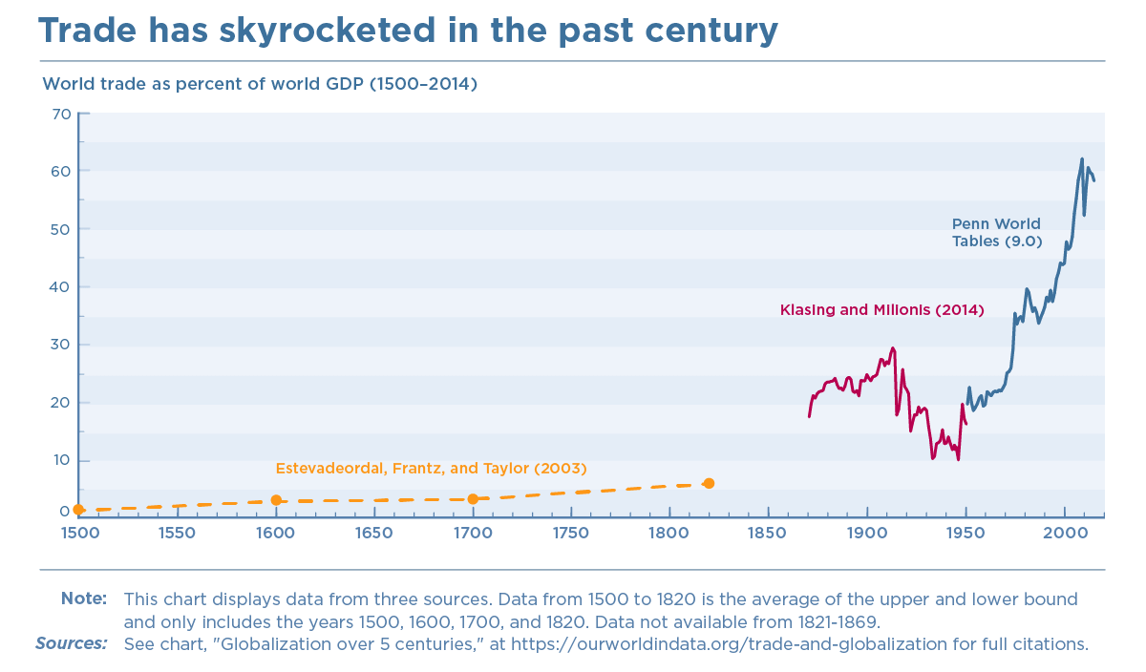
1. Why international trade matters High degree of international trade integration
The world reached a very high degree of international economic integration in general and of trade integration in particular.
The ratio of trade to GDP is a simple and commonly used measure of trade integration; known as trade openness.
Trade integration is an indicator for the degree of globalisation Note: Trade openness is calculated as: [(exports + imports)/2 ] / GDP ]

Slide 4
1. Why international trade matters Trade openness is particularly high in Europe, 2018
Source: OECD, own calculations.

Slide 5
1. Why international trade matters Relevance of trade for organising the economy
‘Opening up the economy’, that is, moving from a state of autarky (closed economy, countries do not engage in trade) to a situation where countries exchange goods with each other (open economy) creates new possibilities.
With international trade goods can be exported and imported which may influence production and consumption decisions of the economies involved.
In particular: in contrast to autarky, in an open economy it need not be the case that production equals consumption.
Closed economy (autarky): consumption (C) = production (Q) by definition
Open economy (goods trade): consumption (C) ≠ production (Q) is allowed
The deviation of production from consumption are equal to the trade flows. When we are interested in which country exports / imports which good we refer to these flows as trade patterns. The trade patterns are a key element in trade analysis.

Slide 6
2. Motives for international trade Countries trade for different reasons
At the most general level, the incentives for countries to engage in international trade stem from
Differences between countries
Differences in technology (Ricardian model)
Differences in factor endowments (Heckscher-Ohlin model)
Increasing returns to scale
A larger market allows spreading fixed costs over larger amounts. Firms can reduce their average costs when they export. (‘New Trade Models’)
Love for variety
If consumers like to consume goods in different varieties (e.g. chocolates of different brands), varieties of the some good are likely to be produced in different countries, giving raise to so-called ‘intra-industry-trade’. Love-for-variety models typically also feature increasing returns in production.

Slide 7
3. Comparative advantage Non-trivial and true
“..years ago …I was in the Society of Fellows at Harvard along with the mathematician Stanislaw Ulam,…..already at a tender age a world famous topologist. He used to tease me by saying, ’Name me one proposition in all of social sciences which is both true and non-trivial’. This was a test I always failed. But now, some thirty years later,…an appropriate answer occurs to me: The Ricardian theory of comparative advantage; …..That it is logically true need not be argued before a mathematician; that it is not trivial is attested by the thousands of important and intelligent men who have never been able to grasp the doctrine for themselves or to believe it after it was explained to them.”
(p. 683, vol. III of the Collected Scientific Papers of Paul Samuelson).

Slide 8
3. Comparative advantage First observations
Comparative advantage is the underlying principle of the most-commonly used trade models.
The essence of comparative advantage is simple: everybody should specialise in the activity they are relative good at.
In the context of international trade everybody means all trade partners. For the ease of exposition, we will study a case with two countries
The activities are the production of goods. We will look at a case with only 2 goods and 2 countries
Being ‘relatively good at’ means producing at relatively lower cost. The emphasis is on relative. If France produces wine at half the cost of Chile and France produces high-speed trains at a tenth of the cost of Chile, then France should specialise in the production of high-speed trains.
Comparative advantage is tightly related to the concept of opportunity costs. If France requires 1000 hours to produce a high-speed trains, these 1000 hours cannot be used to produce wine. The opportunity cost of a high-speed train is the amount of wine that France could have produced with 1000 hours but had to forego when it decided to use them for producing a train.

Slide 9

3. Comparative advantage Comparative advantage and Absolute advantage (1)
Comparative advantage and absolute advantage both describe cost structures.
In standard trade theories, trade patterns are governed by comparative advantage.
Let’s denote the production cost of good 1 as a₁ and that of good 2 by a₂. (they will later also be referred to as labour input requirements)
Let’s assume these production costs differ between country A and country B.
Then there are four production costs: $a_{1}^{A}$ and $a_{2}^{A}$in country A; and $a_{1}^{B}$ and $a_{2}^{B}$in country B.
Absolute advantage compares the production costs for goods directly.
For example, if $a_{1}^{A}<a_{1}^{B},$ then country A has absolute advantage in the production of good 1.
Importantly a country, say country A, can have absolute advantage in both goods, e.g.
$a_{1}^{A}<a_{1}^{B}$ and $a_{2}^{A}<a_{2}^{B}$.

Slide 10

3. Comparative advantage Comparative advantage and Absolute advantage (2)
Comparative advantage compares the relative costs of the two goods between two countries
For example, country A has comparative advantage in good 1 if and only if
$\frac{a_{1}^{A}}{a_{2}^{A}}<\frac{a_{1}^{B}}{a_{2}^{B}}$
This means that the production cost of good 1 is comparatively lower in country A.
Note: in the 2 country – 2 goods case, a country cannot have comparative advantage in both goods.
If country A has comparative advantage in good 1, this means that the opportunity cost of good 1 (i.e. the amount of good 2 it cannot produce when producing 1 unit of good 1) is lower in country A than in country B.
We will apply the concept of comparative advantage in a Ricardian trade model to make predictions about the trade patterns.

Slide 11






4. The Ricardian model of trade Production in the Ricardian model (1)
The basic structure of the Ricardian model is that there are two countries and two goods but only one factor of production which is labour.
Remember the production function (PF): (Q denotes quantity produced)
(φ is the productivity parameter)
With labour as the sole production factor, PF becomes and with
further simplifies to or
With this simple structure it will be convenient to base much of the analysis on the so-called labour input requirement. It is the amount of labour that is needed to produce one unit of output Q.
The labour input requirement is the inverse of (labour) productivity and will be denoted by a, hence:
$$Q=f\left(L,K\right)=φ∙L^{α}∙K^{β}$$
$$Q=f\left(L\right)=φ∙L^{α}$$
$α$=1
$$Q=f\left(L\right)=φ∙L$$
$$Q=φ∙L$$
$$φ=1/a$$
IMPORTANT: This notation deviates from previous lectures where a denoted productivity. This is done in order to be in line with the textbook provided at Brightspace

Slide 12


4. The Ricardian model of trade Production in the Ricardian model (2)
The labour input requirements also reflect the marginal product of labour, MP_{L}.
Wages w are then
This gives us a first flavour of the importance of the labour input requirements because they will determine the domestic prices of goods and – as we shall see – the patterns of trade.
Being the inverse of labour productivity, the labour input requirements reflect the technology of production.
When we consider the production of two different goods across two countries, the technology countries can employ to produce these two goods certainly matters. We can think of a lower a as a better technology.
$$Q=φ∙L ⇔ Q=1⁄a∙L$$
$${w=MP}_{L}∙P = \left(1⁄a\right)∙P$$

Slide 13
4. The Ricardian model of trade Rationale for trade in the Ricardian model
The rationale for international trade are differences in technology. The model explicitly allows for different production cost in the two countries.
Because labour is the only factor of production, the amount of labour needed for the production of one unit of a good directly determines the production cost.
This is known as the labour theory of value which was used by many ‘classical’ economists (as well as by Karl Marx)
We will use the original example of David Ricardo which is the trade of wine against cloth between England and Portugal.

Slide 14
4. The Ricardian model of trade Further model assumptions
Goods (wine and cloth) are tradable
Labour is internationally immobile (workers cannot migrate from England to Portugal or vice versa)
Labour is mobile between the two goods, that is, the workers can be set to produce wine or cloth
There are constant returns to scale
The production technology is fixed and does not change over the period of analysis
We can think of firms which are producing wine and cloth but all firms in England have the same technology and all firms in Portugal have the same technology. Therefore, we can consider countries instead of the individual firms.
The technology in England is different from that in Portugal (for at least one of the two goods).

Slide 15

4. The Ricardian model of trade A concrete example
We assume that Portugal and England each dispose of a labour supply (L) of 1200 working hours, hence $L^{POR}=1200$ and $L^{ENG}=1200$. These hours can be used to produce wine and cloth.
Portugal has the following technology
The production of one gallon of wine requires 4 hours ($a_{W}^{POR}=4$)
The production of one yard of cloth requires 60 hours ($a_{C}^{POR}=60$)
England has the following technology
The production of one gallon of wine requires 12 hours ($a_{W}^{ENG}=12$)
The production of one yard of cloth requires 120 hours ($a_{C}^{ENG}=120$)

Slide 16

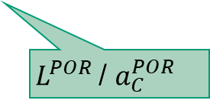


4. The Ricardian model of trade Production possibilities in autarky- Portugal
Let’s first look at the production possibility in Portugal in a situation of autarky:
If Portugal uses all its labour (1200 hours) to produce wine, it can produce 300 ($L^{POR}$/ $a_{W}^{POR}$) gallons.
Conversely, if Portugal puts all its labour into cloth production, it can produce 20 ($L^{POR}$/ $a_{C}^{POR}$) yards.
$L^{POR}$/ $a_{W}^{POR}$
These two points already allow us to draw the production possibility frontier (PPF) for Portugal.
Naturally, Portugal can also allocate its labour to the production of both goods in any proportion it desires. For example, if it uses half of its labour (600 hours) for the production wine, it will produce $Q_{W}^{POR}=150$gallons. This leaves 600 hours for the production of cloth yielding $Q_{C}^{POR}=10$ yards.
(10,150)
$L^{POR}$/ $a_{C}^{POR}$

Slide 17

4. The Ricardian model of trade Full employment, PPF and opportunity costs
An analogous line of reasoning yields the PPF for England (check if can derive it yourself)
The limits of production are hence defined by the technologies and the labour supply of countries
Portugal: $a_{W}^{POR} ∙ Q_{W}^{POR}+$ $a_{C}^{POR} ∙ Q_{C}^{POR}≤L^{POR}$
England: $a_{W}^{ENG} ∙ Q_{W}^{ENG}+$ $a_{C}^{ENG} ∙ Q_{C}^{ENG}≤L^{ENG}$
Let’s use the English PPF to derive the reconsider the opportunity costs.
The opportunity cost of producing 1 yard of cloth is 10 gallons of wine. This opportunity cost of cloth (more generally of the good on the x-axis) can be read off directly from the graph: it is the absolute value of the slope of the PPF.

Slide 18
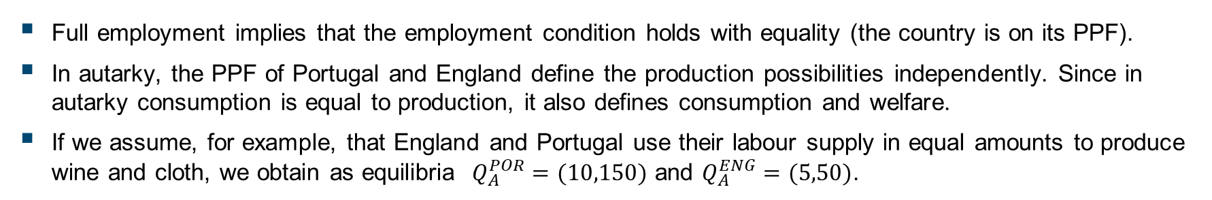
4. The Ricardian model of trade Production in autarky – An example
Full employment implies that the employment condition holds with equality (the country is on its PPF).
In autarky, the PPF of Portugal and England define the production possibilities independently. Since in autarky consumption is equal to production, it also defines consumption and welfare.
If we assume, for example, that England and Portugal use their labour supply in equal amounts to produce wine and cloth, we obtain as equilibria $Q_{A}^{POR}=(10,150)$ and $Q_{A}^{ENG}=(5,50)$.
(10,150)
(5,50)

Slide 19

4. The Ricardian model of trade Production choices: wages, prices and technology – Portugal
In the simple one-factor economy, the production choices are driven by wages to be earned when producing wine (in Portugal $w_{W}^{POR}$) compared to the wage earned when producing cloth (in Portugal $w_{C}^{POR}$).
Portuguese workers will prefer to produce wine if $w_{W}^{POR}>w_{C}^{POR}$ and cloth if $w_{W}^{POR}<w_{C}^{POR}$.
The wages in turn are determined by labour input requirements and prices:
$w_{W}^{POR}={P_{W}^{POR}}/{a_{W}^{POR}}$ and $w_{C}^{POR}={P_{C}^{POR}}/{a_{C}^{POR}}$
Hence, Portuguese workers will prefer to produce wine if ${P_{W}^{POR}}/{a_{W}^{POR}}>{P_{C}^{POR}}/{a_{C}^{POR}}$ and prefer to produce cloth if ${P_{C}^{POR}}/{a_{C}^{POR}}>{P_{W}^{POR}}/{a_{W}^{POR}}$.
Producing both goods requires that the wage are the same in both goods: ${P_{W}^{POR}}/{a_{W}^{POR}}={P_{C}^{POR}}/{a_{C}^{POR}}$ or
$$\frac{P_{W}^{POR}}{P_{C}^{POR}}=\frac{a_{W}^{POR}}{a_{C}^{POR}} ⇔ \frac{P_{C}^{POR}}{P_{W}^{POR}}=\frac{a_{C}^{POR}}{a_{W}^{POR}}$$
The latter relationship is crucial: it says that producing both goods requires that relative product prices are equal to the relative labour input requirements.
Hence, in a situation without trade between the two countries (autarky) the relative price of goods is determined by the domestic cost structures.

Slide 20
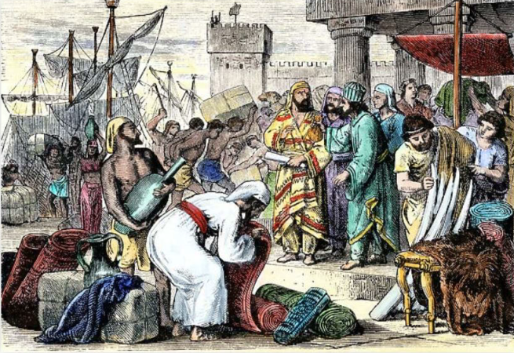
4. The Ricardian model of trade Opening to trade
The opening up to trade entails a number of consequences and raises the following questions:
Which trade patterns will emerge? (and how will the associated production and consumption structures look like)
How will (relative) prices change?
(and which form of specialisation will result from that)
Will there be gains from trade? (and which country will reap them?)
Ancient Phoenician traders in port
© North Wind Picture Archives

Slide 21

4. The Ricardian model of trade Trade patterns (1)
When Portugal and England open up to trade, they can export and import wine and cloth
We can evoke the concept of comparative advantage to predict which country will export wine and which country will export cloth (Note: Portuguese exports of, say wine, are equal to imports of wine by England).
More specifically, England will export cloth, if it has comparative advantage in producing cloth. This is the case if England’s labour input requirements for producing cloth relative to those for producing wine are lower than in Portugal:
$$\frac{a_{C}^{ENG}}{a_{W}^{ENG}}<\frac{a_{C}^{POR}}{a_{W}^{POR}}$$
The intuition is that if the relative labour input requirements of cloth are lower in England, then the opportunity costs of cloth are lower (that is the amount of wine foregone) than in Portugal.
If countries ‘specialise’ in production according to comparative advantage, the joint production of the two countries exceeds that of the sum of the individual production possibilities in autarky.

Slide 22
4. The Ricardian model of trade Trade patterns (2)
If England specialises to produce and exports cloth, then it must be that Portugal exports wine.
This is because a country cannot have comparative advantage in all goods.
Let’s calculate the relative labour input requirements, that is, the opportunity costs of the two countries and the resulting comparative advantage.

Slide 23
4. The Ricardian model of trade Trade patterns (2)
If England specialises to produce and exports cloth, then it must be that Portugal exports wine.
This is because a country cannot have comparative advantage in all goods.
Let’s calculate the relative labour input requirements, that is, the opportunity costs of the two countries and the resulting comparative advantage.

Slide 24
4. The Ricardian model of trade Trade patterns (2)
If England specialises to produce and exports cloth, then it must be that Portugal exports wine.
This is because a country cannot have comparative advantage in all goods.
Let’s calculate the relative labour input requirements, that is, the opportunity costs of the two countries and the resulting comparative advantage.

Slide 25
4. The Ricardian model of trade Trade patterns (3)
Given the technology (labour inputs requirements) of the two countries, Portugal exports wine while England exports cloth in this example.
Note that this trade pattern results despite the fact that Portugal has absolute advantage in both goods.
The exact amount of exports and imports and resulting production and consumption patterns depend on relative prices.

Slide 26
4. The Ricardian model of trade Relative prices (1)
Assuming that in autarky (situation where economies are ‘closed’ to trade), both countries produce both goods, the prices are determined by domestic costs structures (technology) only.
When international trade is allowed, the prices will be affected by global supply and global demand.
That price determination is more complex with international trade is obvious, given that the price of each good ought to be the same in the two countries.
Put differently, countries’ incentive to trade stems from the possibility to obtain goods at different – lower – prices than those associated with domestic cost structures.
Given that we must keep track of both markets we will look at relative price, relative supply and relative demand for both goods.
Reminder: With international trade, production in any country can differ from consumption.

Slide 27

4. The Ricardian model of trade Relative prices (2)
The relative price of cloth is simply $\frac{P_{C}}{P_{W}}$.
Relative world supply is $\frac{Q_{C}^{POR}+Q_{C}^{ENG}}{Q_{W}^{POR}+Q_{W}^{ENG}}$and will be denoted as RS.
Note that the full employment condition also acts as a constraint for global supply:
$\left({a_{C}^{POR}∙Q}_{C}^{POR}+a_{C}^{ENG}Q_{C}^{ENG}\right)+\left({a_{W}^{POR}∙Q}_{W}^{POR}+a_{W}^{ENG}∙Q_{W}^{ENG}\right)=L^{POR}+L^{ENG}$
Relative world demand is $\frac{C_{C}^{POR}+C_{C}^{ENG}}{C_{W}^{POR}+C_{W}^{ENG}}$and will be denoted as RD. Note: for any country and good we have C = Q – NX where NX are ‘net exports’: exports - imports
The demand for goods depend on the one hand on preferences but is also influenced by relative prices.
Countries continue to specialise according to comparative advantage.

Slide 28
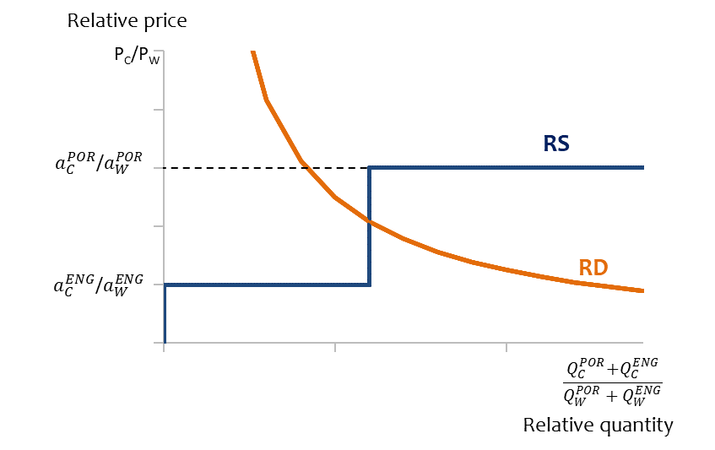
4. The Ricardian model of trade Trade patterns (3)
Trade will only happen at a price range between $a_{C}^{ENG}/a_{W}^{ENG}$and $a_{C}^{POR}/a_{W}^{POR}$

Slide 29
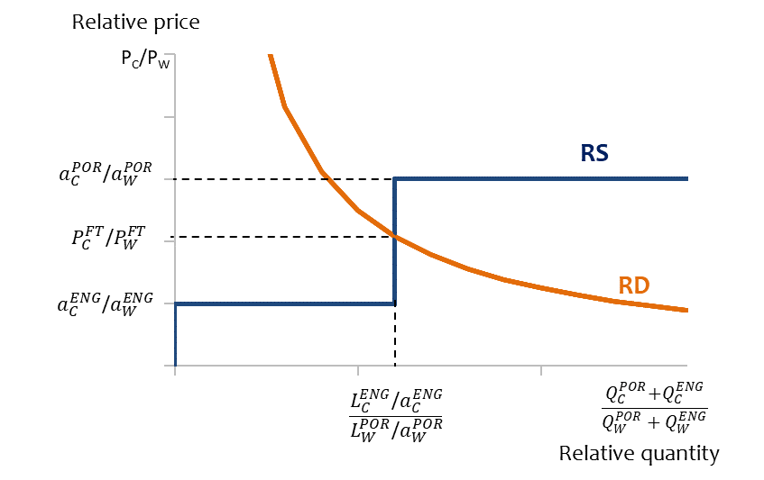
4. The Ricardian model of trade Trade patterns (3)
Trade will only happen at a price range between $a_{C}^{ENG}/a_{W}^{ENG}$and $a_{C}^{POR}/a_{W}^{POR}$
Point FT is the free trade equilibrium at indicated relative demand
Relative supply of cloth with free trade at the indicated relative demand: maximum amount of cloth that England can produce relative to maximum wine that Portugal can produce
Relative price of cloth with free trade (FT) at the indicated relative demand
FT

Slide 30
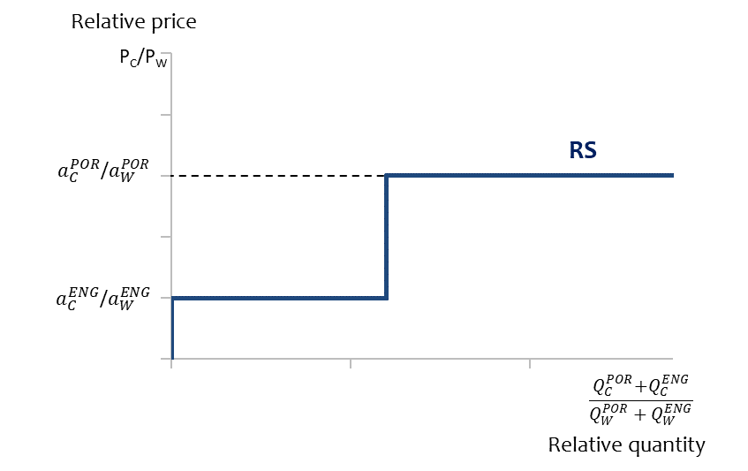
4. The Ricardian model of trade Trade patterns and different forms of specialisation
For P_{C}/P_{W} above a_{C}^{POR} /a_{W}^{POR} : England and Portugal produce cloth only
Incomplete specialisation of Portugal: it produces cloth and wine
Complete specialisation: England produces only cloth; Portugal produces only wine
Incomplete specialisation of England: it produces cloth and wine
No supply of cloth. England and Portugal produce wine only

Slide 31

4. The Ricardian model of trade Trade patterns and different forms of specialisation (con’t)
If the relative price of cloth, $\frac{P_{C}}{P_{W}}$, is such that
$\frac{P_{C}}{P_{W}}<\frac{a_{C}^{ENG}}{a_{W}^{ENG}}$ No production of cloth; no trade; prices remain as in autarky.
$\frac{P_{C}}{P_{W}}=\frac{a_{C}^{ENG}}{a_{W}^{ENG}}$ Incomplete specialisation England; , $\frac{P_{C}}{P_{W}}$ is determined by England’s technology
$\frac{a_{C}^{ENG}}{a_{W}^{ENG}}<$ $\frac{P_{C}}{P_{W}}<\frac{a_{C}^{POR}}{a_{W}^{POR}}$ England and Portugal are completely specialised according to comparative advantage; $\frac{P_{C}}{P_{W}}$ will lie between countries’ pre-trade prices, in dependence of demand.
$\frac{P_{C}}{P_{W}}=\frac{a_{C}^{POR}}{a_{W}^{POR}}$ Incomplete specialisation Portugal; $\frac{P_{C}}{P_{W}}$ is determined by Portugal’s technology
$\frac{P_{C}}{P_{W}}>\frac{a_{C}^{POR}}{a_{W}^{POR}}$ Both England and Portugal produce cloth; no trade; prices remain as in autarky.

Slide 32

4. The Ricardian model of trade Gains from Trade – Full specialisation
Let’s focus first on the case where the relative demand is such that the free trade equilibrium price, $\frac{P_{C}}{P_{W}}$, lies between $\frac{a_{C}^{ENG}}{a_{W}^{ENG}}$and $\frac{a_{C}^{POR}}{a_{W}^{POR}}$. In our numerical example $\frac{P_{C}}{P_{W}}$ would be between 10 and 15 gallons of wine
In this case, the relative free trade price of cloth is different from the autarky prices of cloth in Portugal and England.
Let’s assume demand is such that $\frac{P_{C}}{P_{W}}$ is 12.
This situation is beneficial for both England and Portugal. As shown, with $\frac{P_{C}}{P_{W}}=12$ England fully specialises in the production of cloth. Portugal fully specialises in the production of wine. The production plans are
Cloth: $\frac{L_{C}^{ENG}}{a_{C}^{ENG}}=\frac{1200}{120}=10$
Wine: $\frac{L_{C}^{ENG}}{a_{C}^{ENG}}=\frac{1200}{4}=300$
Free trade (FT) equilibrium of production is at 300/10.

Slide 33

4. The Ricardian model of trade Gains from Trade - England
The international price offers new possibilities for both England and Portugal compared to autarky.
Let’s start in England. Being fully specialised in the production of cloth, England can produce 10 yards of cloth. So $Q_{C}^{ENG}=10.$
Let’s assume that England wants to remain at the consumption point discussed under autarky where it produced and consumed 5 yards of cloth.
We know that $C=Q−X$ which for England in the case of cloth means ${C_{C}^{ENG}=Q}_{C}^{ENG}−X_{C}^{ENG}$ or $C_{C}^{ENG}=10−5=5$
Wine consumption in England is ${C_{W}^{ENG}=Q}_{W}^{ENG}+{IM}_{W}^{ENG}$. But we know that England does not produce wine itself (because it is fully specialise in cloth production), so that $Q_{W}^{ENG}=0$. Remains to find out how much wine England will import, which is equal to the amount of wine it receives for the 5 yards of cloth exported.
With the international price $\frac{P_{C}}{P_{W}}$ equal to 12, English cloth exports, $X_{C}^{ENG}$ , will buy $X_{C}^{ENG}∙$ $\frac{P_{C}}{P_{W}}$ gallons of wine ${{IM}_{W}^{ENG}=X}_{C}^{ENG}∙$ $\frac{P_{C}}{P_{W}}=5∙12=60$. Hence English wine consumption is ${C_{W}^{ENG}=Q}_{W}^{ENG}+{IM}_{W}^{ENG}=0+60=60.$
The English free trade consumption point is therefore (5 ; 60).

Slide 34

4. The Ricardian model of trade Gains from Trade - Portugal
Let’s switch to Portugal. Portugal only produces wine, so it can produce 300 gallons of wine: $Q_{W}^{POR}=300$
We already know that England imports 60 gallons of wine. In the 2-country case it must be that these English imports equal Portuguese exports of wine: ${IM}_{W}^{ENG}≡X_{W}^{POR}$ .
Since ${IM}_{W}^{ENG}$ is 60, we can directly calculate Portuguese wine consumption: ${C_{W}^{POR}=Q}_{W}^{POR}−X_{W}^{POR}=300−60=240.$
Portugal does not produce cloth but it imports 5 yards of cloth from England because ${IM}_{C}^{POR}$ $≡$ $X_{C}^{ENG}$ .
It follows that Portugal’s cloth consumption is ${C_{C}^{POR}=Q}_{C}^{POR}+{IM}_{C}^{POR}=0=5=5.$
The free trade consumption point of (5 ; 240) is clearly outside Portugal’s pre-trade PPF.
It turns out that both consumption points of both countries are outside their PPF. This is an indication that both countries gain from trade. We can check this with the production possibility constraints.
The question is: Could POR and ENG reach these consumption points without trade, i.e. in autarky?
Portugal: $4 ∙240+$ $60 ∙5=1260$. But Portugal’s labour supply is $L^{POR}=1200$. The answer is no!
England: $12 ∙60+$ $120∙5=1320$. But England’s labour supply is $L^{ENG}=1200$. The answer is no!

Slide 35
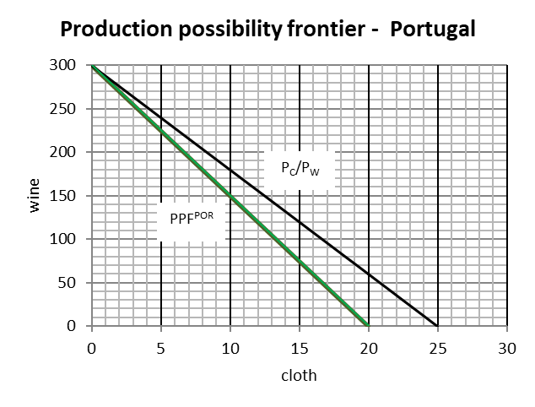
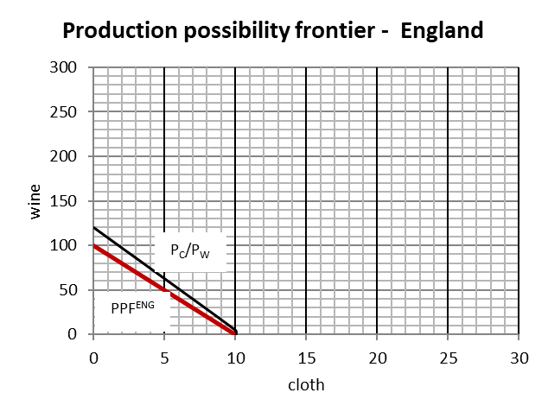
4. The Ricardian model of trade Gains from Trade – graphical representation
England and Portugal can use the international price line to trade outside their domestic PPFs.
Production point
Consumption point (5 ; 240)
Consumption point (5 ; 60)
Production point

Slide 36

4. The Ricardian model of trade Summary of production, consumption, trade
Trade between England and Portugal allows both England and Portugal to have consumption bundles which are impossible under autarky given their technologies and labour supply
Summary of production, consumption and trade flows with trade:
Portugal – Exports: 60 wine ; Imports: 5 cloth ; production; 300 wine; consumption 240 wine, 5 cloth
England – Exports: 5 cloth ; Imports: 60 wine ; production; 10 cloth; consumption 60 wine, 5 cloth
Take again, for example, Portugal’s consumption bundle under free trade: (5,240). Let’s compare that to autarky (in the autarky case the PPF needs to be respected and the black trade line in the previous slide is not available). Let’s search for the point at the Portuguese PPF when it produces and consumes 5 yard of cloth. The answer is: it could produce no more than $\frac{L^{POR}−(Q_{C}^{POR}∙a_{C}^{POR})}{a_{W}^{ENG}}=\frac{1200−300}{4}=225$ gallons of wine. This is obviously less than the 240 gallons Portugal can consume on top of the 5 yards of cloth when it engages in trade with England! The same case can be made for England!

Slide 37

4. The Ricardian model of trade Gains from Trade – other types of specialisation
Having analysed the case with both countries fully specialising in production, let’s move on to the other possible cases.
Two cases – those without trade – can be dealt with quickly of course, because without trade there are also no gains from trade
Remain the two cases with incomplete specialisation of one of the two countries
Incomplete specialisation England: In this case the relative prices for England do not change. This is because the world price is determined by England’s technology $\frac{P_{C}}{P_{W}}=\frac{a_{C}^{ENG}}{a_{W}^{ENG}}$. As a result, all the gains from trade accrue to Portugal!
Incomplete specialisation Portugal: In this case the relative prices for Portugal do not change. This is because the world price is determined by Portugal’s technology $\frac{P_{C}}{P_{W}}=\frac{a_{C}^{POR}}{a_{W}^{POR}}$). Hence, all the gains from trade accrue to England!

Slide 38
4. The Ricardian model of trade Gains from Trade – other types of specialisation (con’t)
More generally, in the case of one country being incompletely specialised, it is always the fully specialised country which reaps all the gains from trade.
In practical terms, this means that the smaller country (in terms of production capacity) is more likely to gain from trade, because it is typically the larger country which remains incompletely specialised.

Slide 39
5. Discussion and Limitations Model assumptions
The assumptions of the model are very strict. Some assumptions, which may not be necessarily fulfilled:
‘atomistic firms’: global markets are increasingly oligopolistically organised. These firms have impacts on prices and market outcomes are dependent of firms’ strategies. However, Helpman and Krugman (1986, p 261) argue that in the presence of imperfect competition “comparative advantage is alive and well”. Lines of argumentation include: (i) opening up to trade increases competition; (ii) important prices for consumers decline; (iii) possibly in ‘natural’ export industries profits may increase (larger markets, spreading of fixed costs).
Fixed technology: Technological progress is assumed away as are technological spillovers between countries. This is particularly troublesome as differences in technology are the motive for trade.
Adjustment costs/labour mobility: it is assumed that labour can produce any good without switching costs.
Full employment: The argument of specialization according to comparative advantage becomes much harder to argue for, when there are free resources (because the opportunity costs change).

Slide 40
5. Discussion and Limitations The static nature of the model, interpretations and policy implications
Arguably more troubling than the deviations from the assumptions (modelling necessary requires assumptions) are the interpretations and policy recommendations drawn from the model.
The common policy recommendation derived from the Ricardian trade model is that countries will be ‘better off’ – that is they gain in terms of welfare – when they open up to trade. Indeed, we saw that with trade Portugal and/or England can afford consumption bundles which were previously not obtainable. (Note: David Ricardo himself used his reasoning to argue against the English Corn Laws)
Drawing far reaching policy conclusions from utterly simplistic models is known as "Ricardian Vice“
It is one thing to say that under a certain set of assumptions, trading partners will reap gains from trade (this is a positive statement). A completely statement is that countries should open up for trade (this is a normative statement).

Slide 41

5. Discussion and Limitations Trade between a stone age and an ICT economy: A thought experiment
The economist Eric Reinert used a thought experiment to illustrate the inadequacy of the static nature of the Ricardian model (Reinert, 2007, pp. 301-304).
Imagine a stone age economy and an ICT economy. The two economies will engage in international trade.
The two goods which are produced and traded are stone products and computers.
Reinert’s main point is that ignoring the role of technological change and economic development in the context of trade leads to irrelevant and misleading policy conclusions.

Slide 42
5. Discussion and Limitations Trade between a stone age and an ICT economy: A thought experiment
According to the Ricardian model specialisation and export patterns are determined by comparative advantage.
Reinert assumes that the ICT economy is more productive and holds absolute advantage in the production of stone goods and computers.
Let’s assume that the ICT economy has comparative advantage in computers.*
We know that in this case, the ICT economy specialises in the production of computers while the stone-age economy specialises in the production of stone goods.
If both economies fully specialise, the static gains from trade materialise and accrue to both economies.
In Reinert’s view, however, international trade locks-in the stone-age economy in its current state of technology (because it solely produces stone-age products).
* This deviates slightly from the example given by Reinert but the main conclusions remain fully intact.

Slide 43
5. Discussion and Limitations Trade, development and a dynamic perspective (1)
Reinert’s line of reasoning is that the static (and once-off) gains from specialisation are dwarfed by the negative developmental consequences of ‘backward’ economies induced by specialisation.
In a historical context, he also argues that the specialisation of developing countries in agricultural products and the specialisation of developed countries in industrial products created such lock-in effects (he relates it also to colonialism). Hence, specialisation according to comparative advantage may cause a development trap.
This is a ‘structuralist’ view of economic development. Structuralists emphasise differences in the characteristics of economic activities and sectors (e.g. agriculture versus industry versus services, or high-tech manufactures versus low-tech manufactures, etc.)
A major structuralist argument is that different economic industries may have very different implications for the growth and development prospects of countries, inter alia via innovation and technological change. The static nature of the Ricardian model rules out all these phenomena.

Slide 44
5. Discussion and Limitations Trade, development and a dynamic perspective (2)
Building on Reinert’s argument and using his stone-age economy example, the Italian economist Giovanni Dosi argues that the observed production patterns may reflect predominantly absolute advantage (differences in productivity) rather than comparative advantages (differences in relative prices).
Even if the stone-age economy specialises in the production of and exports stone-age goods, the productivity advantage of the ICT economy makes it likely that it produces much more of the stone-age goods than the stone-age economy – on top of producing all computers.
While slightly different, this argument also emphasises the importance of dynamics, notably the importance of technological capabilities and the evolution of these capabilities.

Slide 45
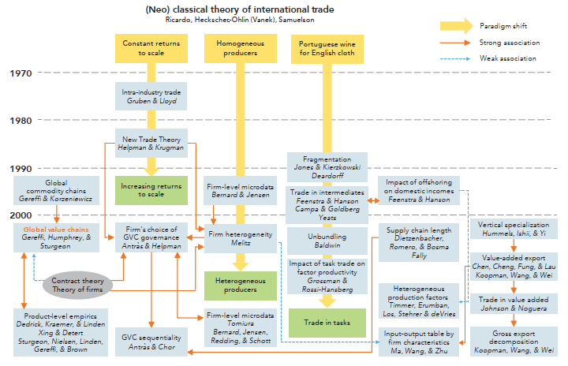
6. Alternative trade models Overview
Source: Inomata (2017)

Slide 46
6. Alternative trade models The Heckscher-Ohlin model
The Heckscher-Ohlin (H-O) model is another workhorse model in economics.
It assumes two-countries, two goods, two factors (labour and capital)
The motive for trade are differences in factor endowments.
To keep the model tractable, identical technologies are assumed.
Important model outcomes are that
Countries specialise according to comparative advantage which are here the result of differences in the factor endowments with labour and capital. The country with relative abundance of capital will specialise in the production of the goods that uses this factor intensively.
The static gains from trade arise also in the H-O model
Under certain conditions (no factor reversals in particular), factor prices will equalise in the two countries

Slide 47
6. Alternative trade models The Heckscher-Ohlin model (con’t)
The slightly more complex (though still fully static) structure of the H-O model allows for interesting analyses of changes in prices and endowments:
An increase in the relative price of a good will increase the real return to the factor used intensively in that good, and reduce the return to the other factor (Stolper-Samuelson Theorem).
An increase in the endowment of one factor will increase the output of the industry using this factor intensively and will decrease the output of the other industry.

Slide 48
Summary and take-aways
Most countries in the world are ‘open economies’, in the sense that international trade in goods plays an important role in the economy.
The major motives for trade are differences between countries and increasing returns to scale.
In the Ricardian model, countries have an incentive to trade because of differences in technology
In the Ricardian model countries specialise according to comparative advantage
Comparative advantage and the associated opportunity costs determine the trade patterns (that is which country exports and imports which good)
In the Ricardian model framework, countries can reap gains from trade, hence the welfare of at least one country increases when there is the possibility for international trade.
A noticeable shortcoming of the Ricardian model (as well as most workhorse models in international trade) is that it is fully static and neglects the technological change and economic developments which limits is usefulness for deriving policy conclusions.

